Slide 1
CMSC 304
Type Equivalence
Claire Sparks

Slide 2
Type Equivalence
Type equivalence: when are two types the same?
One way: Can compare the sets of values as sets
  They are the same if they contain the same values
Structural equivalence: two data types are the same if they have the same structure
  Built in the same way using the same type constructors from the same composite types
  This is one of the principal forms of type equivalence in programming languages

Slide 3
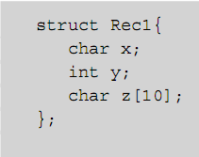
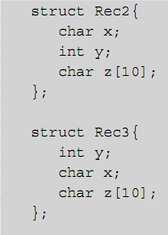
Structural Equivalence
Example:
  Rec1 and Rec2 are structurally equivalent
  Rec1 and Rec3 are not structurally equivalent (char and int fields are reversed)

Slide 4
Structural Equivalence
Structural equivalence is relatively easy to implement
  Provides all the information needed to perform error checking and storage allocation
To check structural equivalence, a translator may represent types as trees and check equivalence recursively on subtrees
Questions still arise over how much information is included in a type under the application of a type constructor

Slide 5

Structural Equivalence
Example: are A1 and A2 structurally equivalent?
  Yes, if size of the index set is not part of an array type
  Otherwise, no
Similar question arises regarding member names of structures

Slide 6
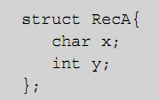
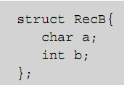
Structural Equivalence
Example: Are these two structures structurally equivalent?
  If structures are considered to be just Cartesian products, then yes
  However, they are typically not considered equivalent, because variables of different structures would have to use different names to access member data
Notes:
Now again, why does this matter? Well imagine source code analysis looking for the behavior of malicious code.

Slide 7
Structural Equivalence
Type names in declarations may or may not be given explicitly
  In C, variable declarations can use anonymous types
  Names can also be given right in structs and unions, or by using a typedef
Structural equivalence when type names are present can be done by simply replacing each name by its associated type expression in its declaration

Slide 8
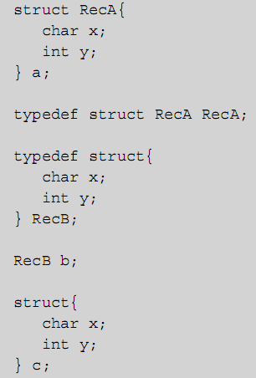
Structural Equivalence
Example: in C code
  Variable a has two type names: struct RecA and RecA (given by the typedef)
  Variable b has only the name RecB (the struct name was left blank)
  Variable c has no type name at all (only an internal name not usable by the programmer)

Slide 9
Name Equivalence
Name equivalence: two types are the same only if they have the same name
  Easier to implement than structural equivalence, as long as every type has an explicit name
  Two types are equivalent only if they are the same name
  Two variables are type equivalent only if their declarations use exactly the same type name

Slide 10
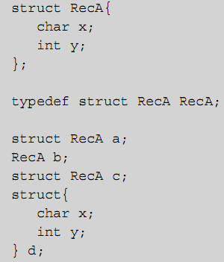
Name Equivalence
Example: in C code:
  a, b, c, and d are structurally equivalent
  a and c are name equivalent, and not name equivalent to b or d
  b and d are not name equivalent to any other variable

Slide 11
Type Equivalence
Ada implements a very pure form of name equivalence
  Requires type names in variable and function declarations in virtually all cases (array is only exception)
C uses a form of type equivalence that falls between name and structural equivalence:
  Name equivalence for structs and unions
  Structural equivalence for everything else

Slide 12
Type Equivalence
Java’s approach is simple:
  It has no typedefs
  class and interface declarations implicitly create new type names, and name equivalence is used for these types
  Arrays use structural equivalence, with special rules for establishing base type equivalence

Slide 13
One More Thing…

Slide 14
Dynamic Scoping
If symbol table is managed dynamically (during execution), declarations will be processed as they are encountered along an execution path
  This is called dynamic scoping
In a language with dynamic scoping, an interpreter must initialize and maintain a symbol table at run time

Slide 15
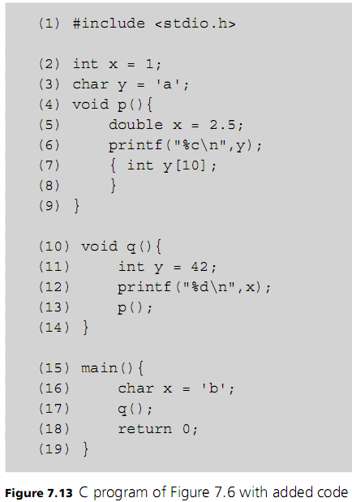

Slide 16
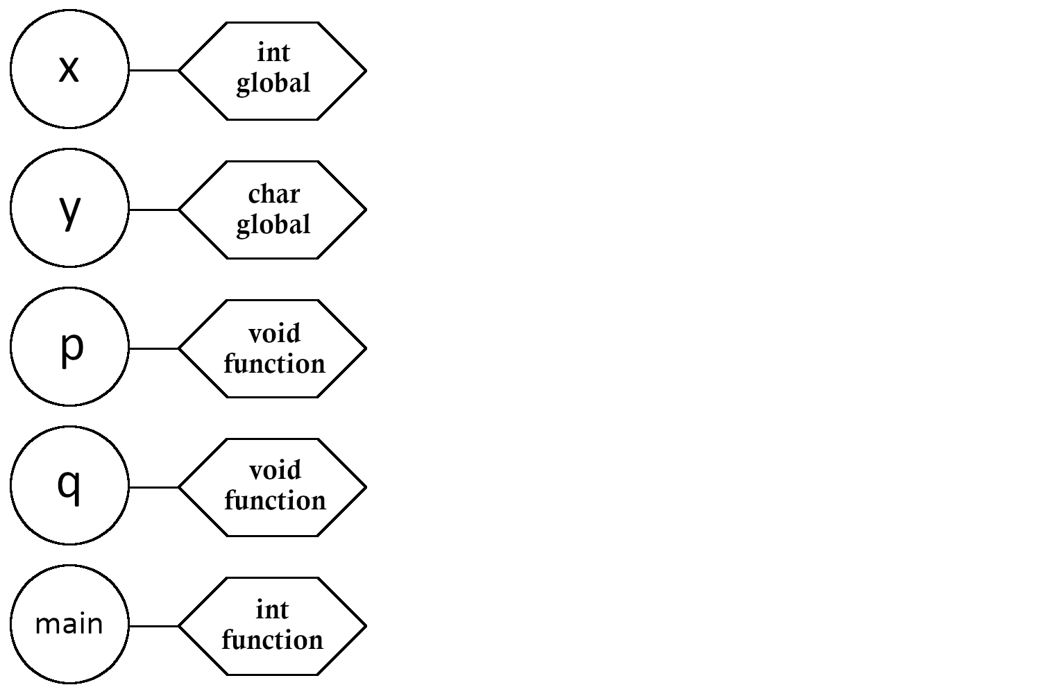
NOTE: for dynamic scoping to work, all global identifiers must be bound to their global attributes at the start of execution

Slide 17
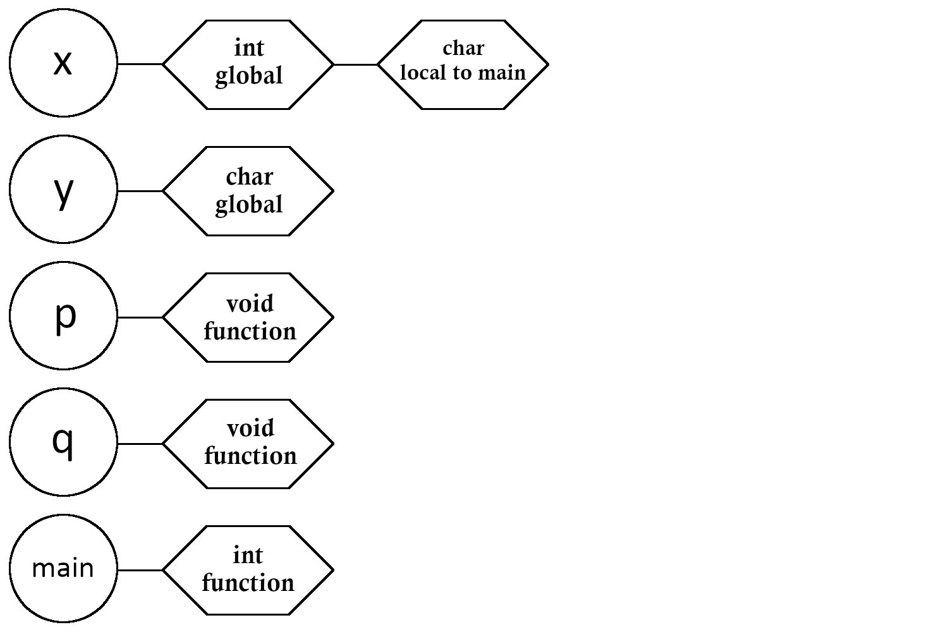

Slide 18
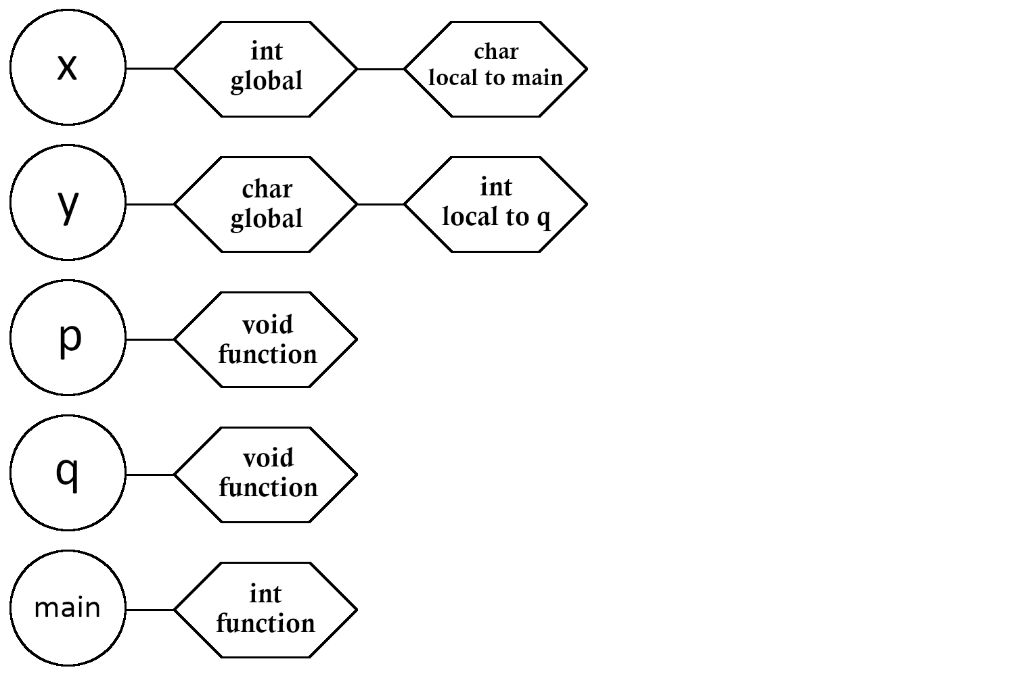
NOTE: each call to q may have different symbol table on entry depending on the execution path.

Slide 19
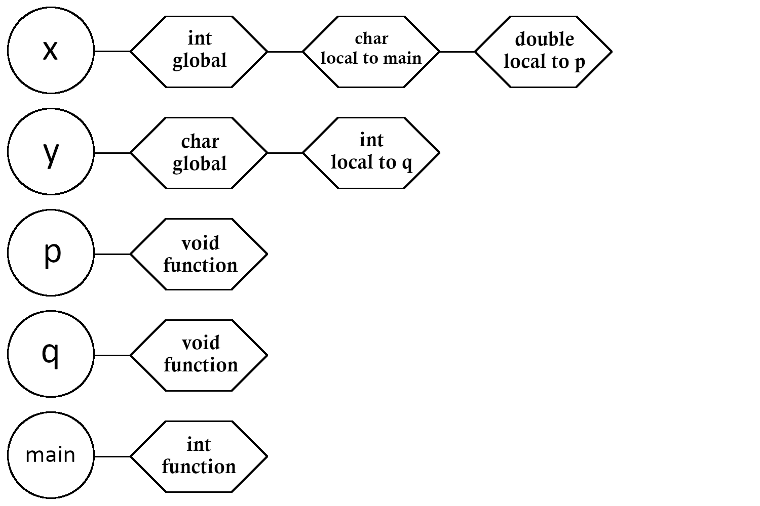

Slide 20
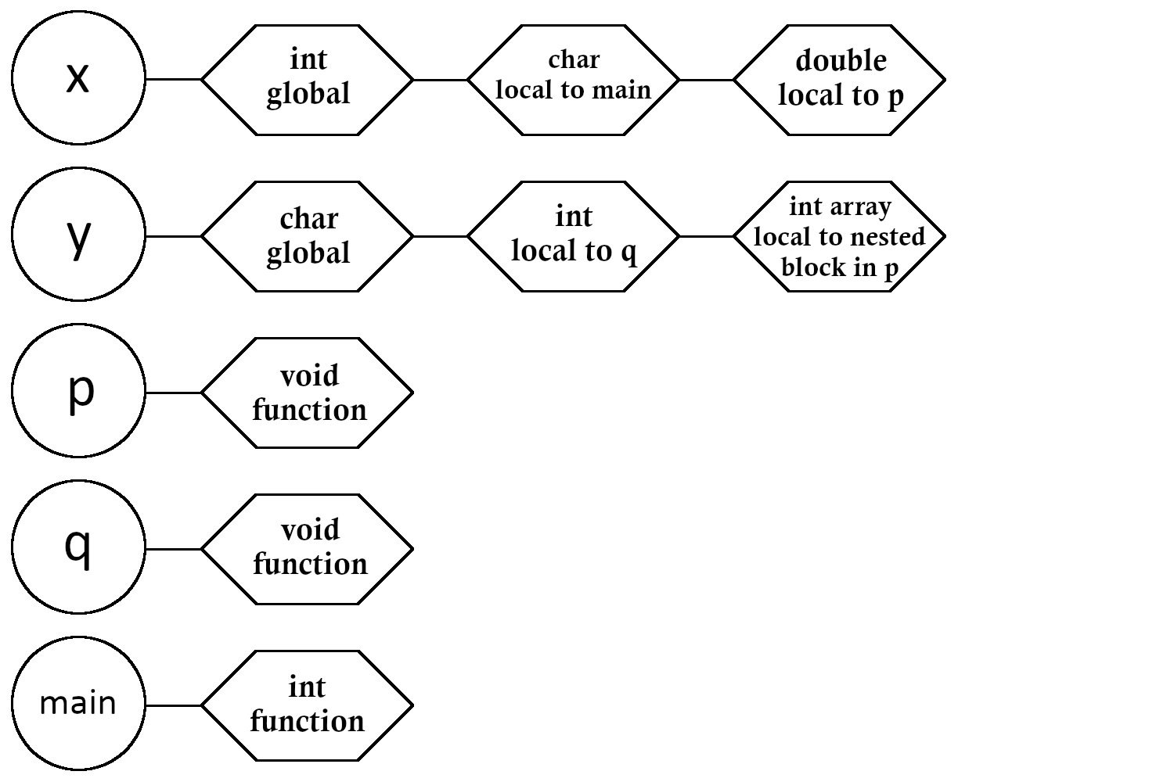

Slide 26
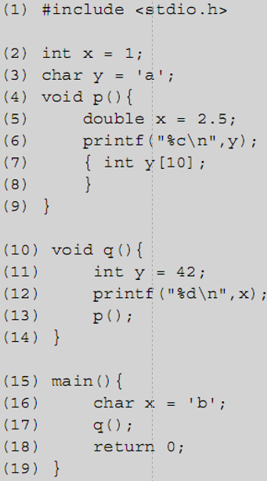




Dynamic Scoping
Dynamic scoping will affect the meaning of the program and produce different output
Output using static scoping:
Output using dynamic scoping:
Dynamic scope can be problematic,
which is why few languages use it
The nonlocal references to y and x inside p and q can change depending on the execution path.
Notes:
Dynamic scoping output has to do with the output types of the print statements
Why is it problematic? *Next slide*

Slide 27
Dynamic Scoping
Problems with dynamic scoping:
  The declaration of a nonlocal name cannot be determined by simply reading the program: the program must be executed to know the execution path
  Since nonlocal variable references cannot be predicted prior to execution, neither can their data types
Dynamic scoping is a possible option for highly dynamic, interpreted languages when programs are not expected to be extremely large

Slide 28
Dynamic Scoping
Runtime environment is simpler with dynamic scoping in an interpreter
  APL, Snobol, Perl, and early dialects of Lisp were dynamically scoped
  Python and Common Lisp use static scoping
Notes:
Modern Perl supports both dynamic and static scoping

